Slide 1
Shell Bootcamp 2024 5 Reflections for Week 01
Sushma Singh
Date : 31-Aug-2024

Slide 2

About Me
Be a better version of yourself than Yesterday…
Please share an image / visual that best represents you

Slide 3

My learnings from this week!

Slide 4
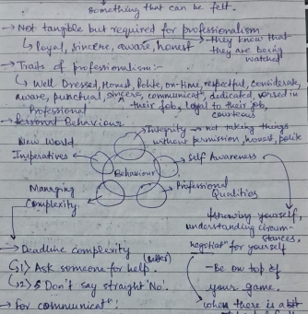
Learning 1 | My takeaways
Key learning: Professional Behavior
Key takeaway: Self-Grooming Techniques, Attributes of a Professional
In the energy sector, professional ethics are crucial for safety standards and compliance.

Slide 5
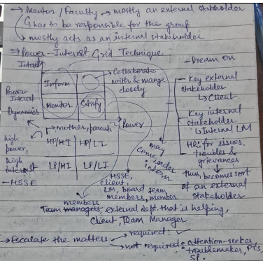
Learning 2 | My takeaways
Key learning: Stakeholders
Key takeaway: Stakeholder management and engagement
In the energy sector, managing stakeholders is crucial because of the diverse groups involved, including governments, regulatory bodies, communities, investors, and environmental organizations.

Slide 6
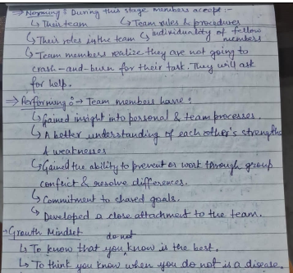
Learning 3 | My takeaways
Key learning: Teamwork
Key takeaway: Team Development
Team skills support us in complex project executions, leadership and mentoring, and building trust and communications, etc.

Slide 7
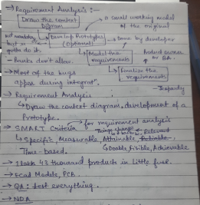
Learning 4 | My takeaways
Key learning: Business Analyst, Software Development Life Cycle (SDLC)
Key takeaway: Software Life Cycle
Utilizing an SDLC in the energy sector ensures that software solution are developed methodically, minimizing risks and ensuring that systems are reliable and scalable.

Slide 8
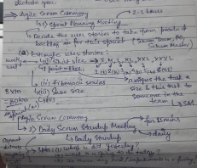
Learning 5 | My takeaways
Key learning: Various SDLC Models
Key takeaway: Agile Model
Adopting Agile in the energy sector benefits professionals by fostering a culture of continuous improvement and flexibility.

Slide 9

Relevance of learnings for my organization

Slide 10
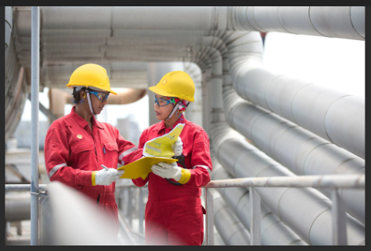
Learning 1 | Relevance for Shell
Shell emphasizes a strong ethical culture, evident through their Code of Conduct, which guides employees in maintaining integrity, safety, and environmental responsibility.
By instilling a strong ethical culture, Shell mitigates risks related to legal issues, safety violations, and environmental harm.

Slide 11
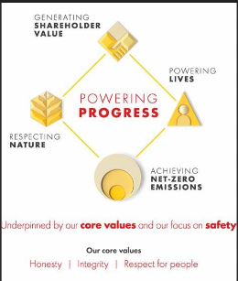
Learning 2 | Relevance for Shell
Shell actively manages its relationships with a wide range of stakeholders, from local communities and governments to investors and NGOs.
Effective stakeholder management helps Shell to minimize conflicts, secure licenses to operate, and foster goodwill in the communities where they operate.

Slide 12
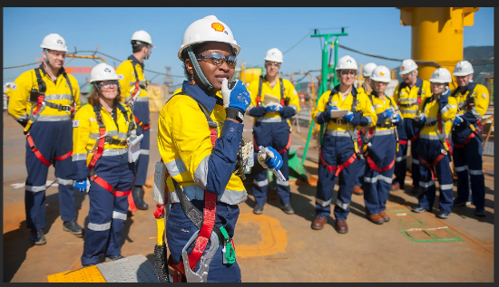
Learning 3 | Relevance for Shell
Shell fosters a collaborative culture where teamwork is essential for achieving operational excellence.
By promoting teamwork, Shell ensures that projects are executed safely and efficiently, leveraging the collective expertise of its workforce.

Slide 13

Learning 4 | Relevance for Shell
At Shell, BAs play a crucial role in identifying business needs, defining project requirements, and ensuring that IT solutions align with organizational goals.
A well-structured SDLC helps Shell ensure that software solutions are robust, secure, and tailored to meet the unique demands of the energy sector.

Slide 14
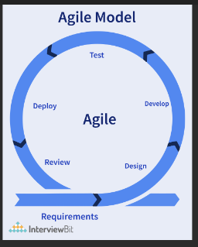
Learning 5 | Relevance for Shell
Shell likely implements Agile in most of the projects where quick iterations and regular feedback are crucial.
The Agile model benefits Shell by allowing teams to be more responsive to change, deliver value faster, and continuously improve their work.

Slide 15

Challenges in implementing learning

Slide 16
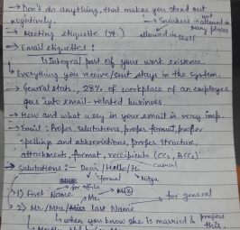
Challenge faced while implementing Learning 1
Challenges: The difference in the rules of etiquette from college and corporate
Plan to Overcome: Keep practicing the corporate etiquettes to understand them better and integrate them into my life
GitHub Link:
https://github.com/AhinRain/Freshers-Technical-Training

Slide 17
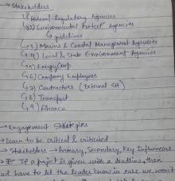
Challenge faced while implementing Learning 2
Challenges: The concept and its intricacies
Plan to Overcome: Learn about the topic more to understand it better.
GitHub Link:
https://github.com/AhinRain/Freshers-Technical-Training

Slide 18
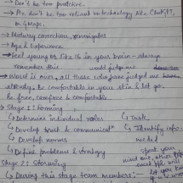
Challenge faced while implementing Learning 3
Challenges: Team formation and making everyone in the team head
Plan to Overcome: Work with various teams and peoples going forward to understand teams and in general, people better
GitHub Link:
https://github.com/AhinRain/Freshers-Technical-Training

Slide 19
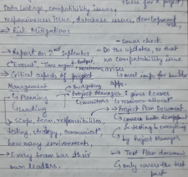
Challenge faced while implementing Learning 4
Challenges: The various documents involved in the SDLC
Plan to Overcome: Keep learning about SE and SDLC and practice the various stages to get familiar with them
GitHub Link:
https://github.com/AhinRain/Freshers-Technical-Training

Slide 20
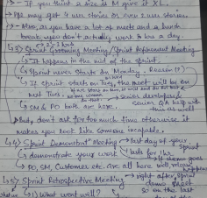
Challenge faced while implementing Learning 5
Challenges: The various connections of the Agile model and Scrum Framework (they are kind of new to me)
Plan to Overcome: Keep learning about Agile and Scrum and practice the various concepts to get familiar with them
GitHub Link:
https://github.com/AhinRain/Freshers-Technical-Training

Slide 21

Action Plan

Slide 22
My Action Plan for this Week
Actions
Timeline
Status
Try to make notes during the sessions to refer to them afterwards
Practice and learn the various concepts on my own as well
The planned timeline to implement first action is till the training ends
As for the learning, it will continue even after the training
Made notes for all the sessions conducted
Learnt about the various concepts after the sessions

Slide 23

Learning is also Fun!

Slide 24

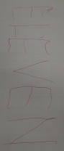
Learning is also Fun!
Group Activity: Presentation (BRD and SRS)
Funny incident: People sharing about their teams in the past based on the CART classification

Slide 25

Summary
The sessions were fun and included a lot of concepts. The first 3-days included Soft skills where we got to learn about Professional Behavior, Email Etiquettes, Active Listening, Business Etiquettes, Teamwork, Stakeholders, etc. As for the Technical sessions, we got to learn about BA, SDLC, SDLC Models, Agile Model, Scrum Framework, etc.
The topics for the upcoming week will include the technical concepts required for us as software engineers and will have a lot of importance in our career.
The current week build a foundational base for the upcoming weeks topics.

Slide 26
Thank You

